Slide 1
Data Modeling
Ling Xue

Slide 2
Relational DB Design
Objective: Converting a data problem to a well-designed relational DB
To store data for future queries and operations
Stages: 3 stages from general data demand to an implementable DB
Stage | Focus | Output
Data Modeling | Entities: Types, instances Attributes: Data types, identifiers Relationships: Types (1:M, M:N, 1:1 etc.), cardinalities | Entity-Relationship Diagram
Logical Design | Tables & Keys Normalization: minimize data redundancy | Table Structure
Physical Design | Implement in actual DBMS (e.g. MySQL); Other issues (e.g., security) | Physical DB
Notes:
Free Online ERD Tool: https://app.diagrams.net/

Slide 3
Data modeling
A technique for modeling data
Method for determining what data and relationships should be stored in a database
A graphical representation of a database
Communicates a database design
The goal: identify the facts to be stored in the database
Data modeling requires a partnership between client and analyst
Iterative process – trial and revision
The data model is a working document
Notes:
Free Online ERD Tool: https://app.diagrams.net/

Slide 4
Data Modeling - The building blocks
Entity – thing about which data should be stored (basic building block)
Entity type
Entity instance
Attribute – describes an entity (singular and unique within the model)
Identifier – uniquely distinguishes an instance of an entity
Relationship – describes a linkage between two entities
Relationship degree designate/describe instances between entities (1:1, 1:m, m:m)

Slide 5
Data model quality
Two criteria
A well-formed data model
A high fidelity image

Slide 6
A well-formed data model
No ambiguity
All entities, attributes, relationships, and identifiers are defined
Names are meaningful to the client
Every entity has an identifier
All relationships are represented, using the correct notation
Relationships are labeled to avoid misunderstanding
All attributes of each entity are listed
All attribute names are meaningful and unique.

Slide 7
A high fidelity image
Faithfully describes the world it is supposed to represent
Relationships are of the correct degree
Data model is complete, understandable, and accurate
The data model makes sense to the client

Slide 8
Quality improvement
Is the level of detail correct?
Are all exceptions handled?
Is the model accurate?
Notes:
Product, color, height, wide, length, weight, fabric, number of buttons

Slide 9
Data Modeling
A real estate investment company own many shopping malls. Each mall contains many shops. To encourage rental of its shops, the company gives a negotiated discount to retailers who have shops in more than one mall. Each shop generates an income stream that can vary from month to month because rental is based on a flat rental charge and a negotiated percentage of sales revenue. Also each shop has monthly expenses for scheduled and unscheduled maintenance. The company uses the data to compute its monthly net income per square meter for each shop and for ad-hoc querying.

Slide 10
Data Modeling
Steve operates a cinema chain and has given you the following information: “I have many cinemas. Each cinema can have multiple theaters. Movies are shown throughout the day starting at 11 a.m. and finishing at 1 a.m. Each movie is given a two-hour time slot. We never show a movie in more than one theater at a time, but we do shift movies among theaters because seating capacity varies. I am interested in knowing how many people, classified by adults and children, attended each showing of a movie. I vary ticket prices by movie and time slot. For instance, Lassie Get Lost is 50 cents for everyone at 11 a.m. but is 75 cents at 11 p.m.”

Slide 11
Degree of Relationships
Degree of a relationship
Number of entity types that participate in the relationship.
Unary relationship
Binary relationship
Ternary relationship
Notes:
16
Most relationships are of binary degree. But it is possible to have any number of entities involved in a relationship “Ternary” refers to three. If you have more than that, it is sometimes referred to generically as an “n-ary” relationship.

Slide 12
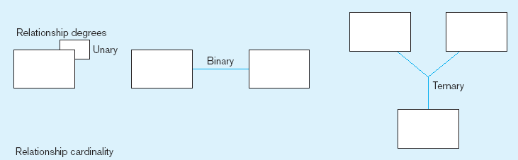
Degree of Relationships
One entity related to another of the same entity type
Entities of two different types related to each other
Entities of three different types related to each other
Notes:
8
One example of unary relationships would be supervisor-subordinate relationships, which exists between employees.

Slide 13
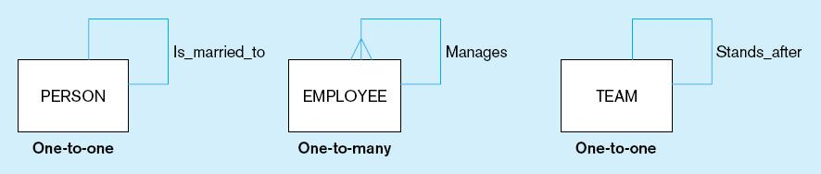
Examples of relationships of different degrees
a) Unary relationships
Notes:
22
Although this figure of unary relationships shows only one-to-one and one-to-many cardinalities, it is also possible to have many-to-many unary relationships. For example consider a Person entity with a “friend” relationship. A particular person can have many friends, and each friend could in turn have other friends. This is different from the one-to-many relationship of employees. Although a supervisor could manage many subordinates, typically a subordinate only reports to one supervisor.

Slide 14
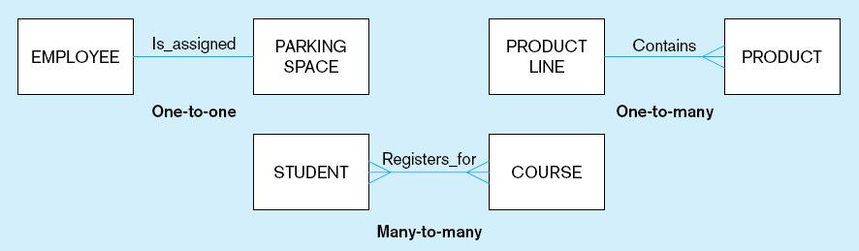
Examples of relationships of different degrees (cont.)
b) Binary relationships
Notes:
22
Here are binary degree relationships with all he different possible cardinalities.

Slide 15
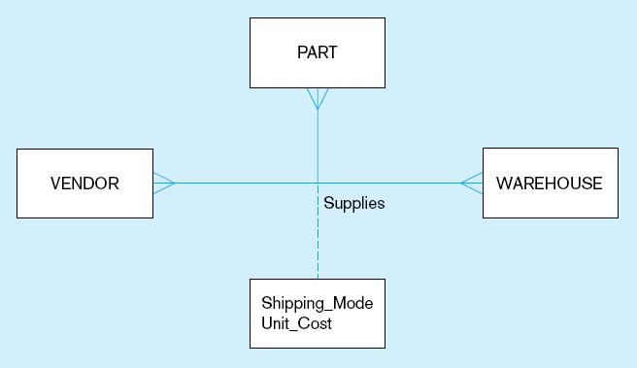
Examples of relationships of different degrees (cont.)
c) Ternary relationship
Note: a relationship can have attributes of its own
Notes:
22
The cardinality of this ternary relationship is many-to-many-to-many. In other words, each vendor could supply many parts to many warehouses. Each part could come from many vendors and housed in many warehouses. Each warehouse could have many parts from many vendors.
The dashed line is a way of representing the attributes of the relationship. For a given vendor supplying a given part to a given warehouse, here is a shipping mode and a unit cost. Each of these ternary relationship instances could have its own shipping mode and unit cost.

Slide 16
Modality & Cardinality
Modality is also known as optionality
Cardinality indicates the range of instances in a relationship
Modality defines the minimum number of instances
Cardinality and modality are linked

Slide 17
Cardinality
Cardinality | Modality | Meaning
0,1 | Optional | There can be zero or one instance of the entity related to the other entity
0,n |  | There can be zero or many instances of the entity related to the other entity
1,1 | Mandatory | There is exactly one instance of the entity related to the other entity
1,n |  | The entity must have at least one and can have many instances related to the other entity
Modality defines the minimum number of instances (rows)
Cardinality indicates the range of instances (rows) in a relationship

Slide 18
Minimalist approach
Focus has been on identifying the basic cardinality (1:m or m:m?)
Now add greater precision—modality
E.g., Is it 0,1 or 1,1?
Learn the basics and then add more detail

Slide 19
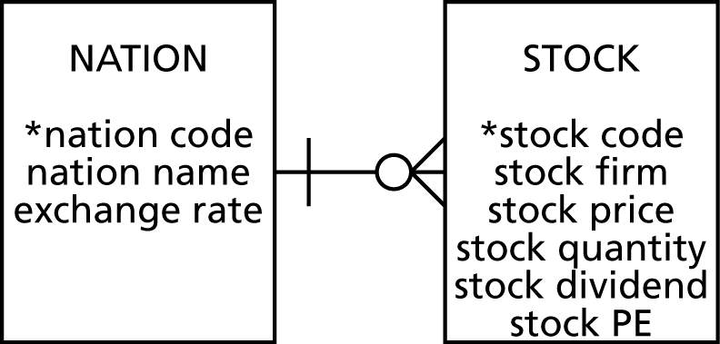
Modality
Optional entity
Cardinality is 0
Indicated by O
Mandatory entity
Cardinality is 1
indicated by l (bar)
Mandatory that an instance of Stock have an instance of Nation
Optional that an instance of Nation have an instance of Stock

Slide 20
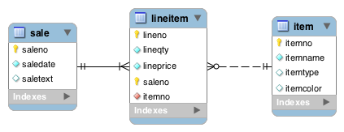
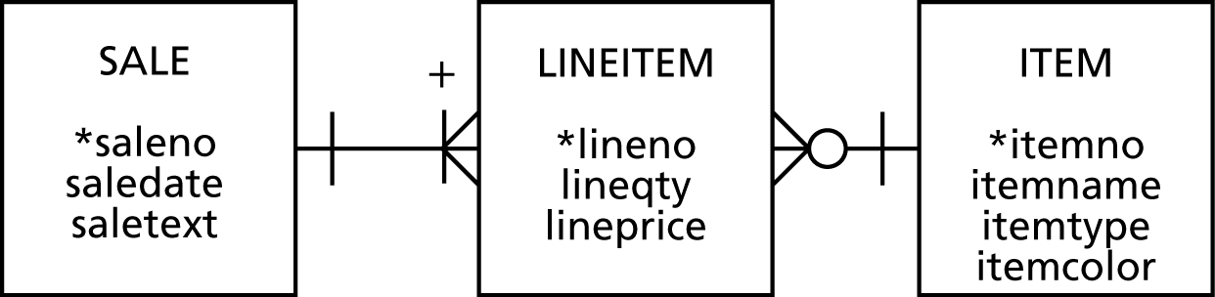
Modality

Slide 21
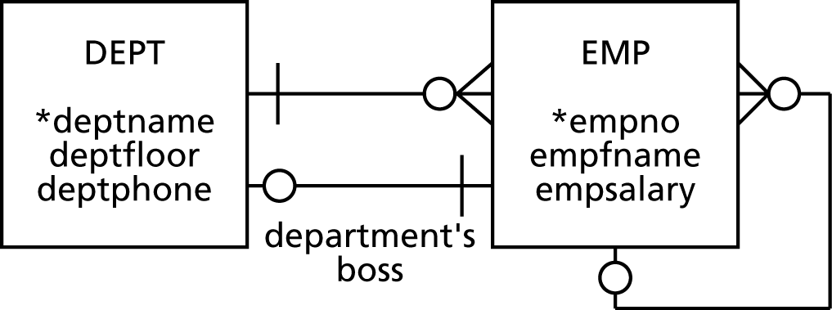
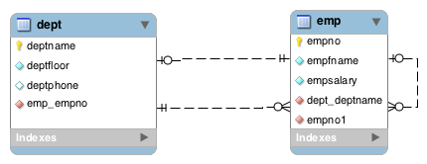
Modality
employee’s boss

Slide 22
Modality
Adds additional information to a data model
If a relationship is mandatory, then add a constraint
Could be
Referential integrity constraint
Application logic

Slide 23
Entity types
Independent
Dependent
Associative
Aggregate
Subordinate

Slide 24
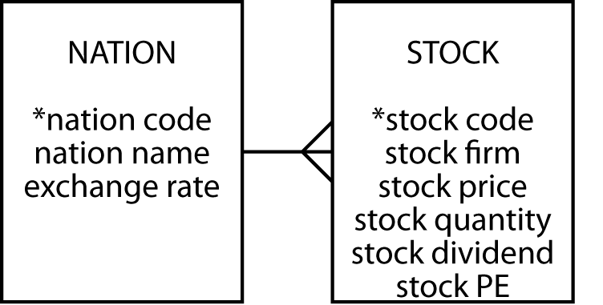
Independent
Often a starting point
Prominent in the client's mind
Often related to other independent entities

Slide 25
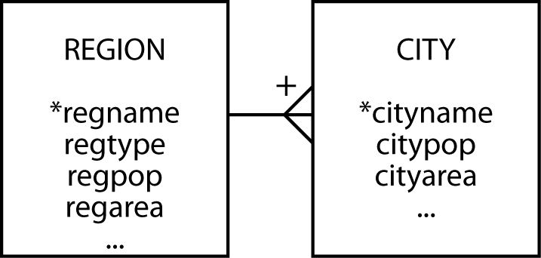
Dependent
Relies on another entity for its existence and identification
Can become independent if given an arbitrary identifier

Slide 26
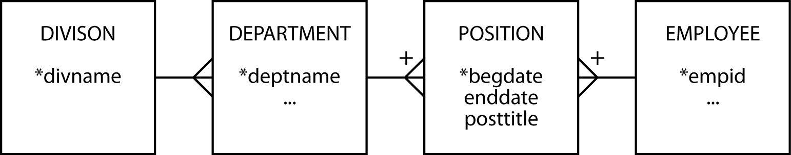
Associative
A by-product of an m:m relationship
Typically between independent entities
Can store current or historical data
Can become independent if given an arbitrary identifier

Slide 27
Aggregate Entity
Created from several different entities that have a common prefix or suffix
Commonly used with addresses or names
Supertype

Slide 28
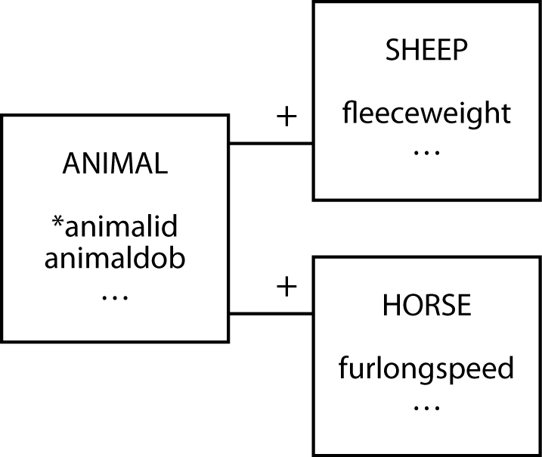
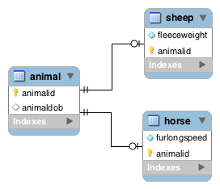
Subordinate Entity
An entity with data that can vary among instances
Subtype

Slide 29
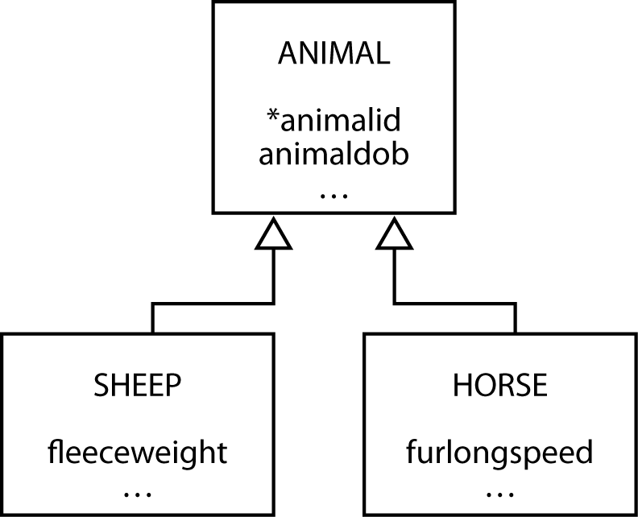
Generalization
A relationship between a more general element and a more specific element

Slide 30
Generalization
Map with one table for each entity
For each of the subtype entities the primary key is that of the supertype entity
You must also make this column a foreign key so that a subtype cannot be inserted without the presence of the matching supertype

Slide 31
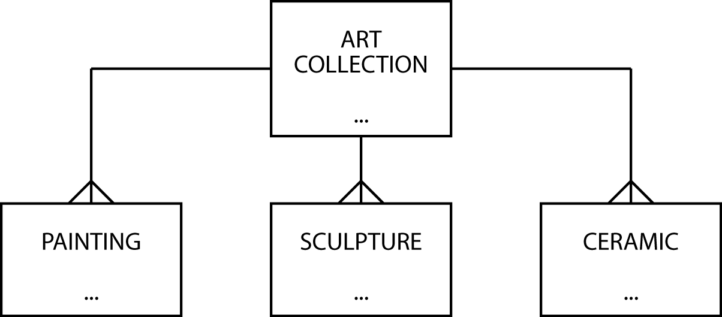
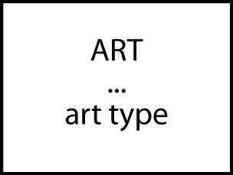
Data model contraction

Slide 32
Hints on data modeling
The model will expand and contract
Invent identifiers where necessary
Identifiers should have only one purpose – identification
A data model does not imply ordering
Create an attribute if ordering of instances is required
An attribute’s meaning must be consistent

Slide 33
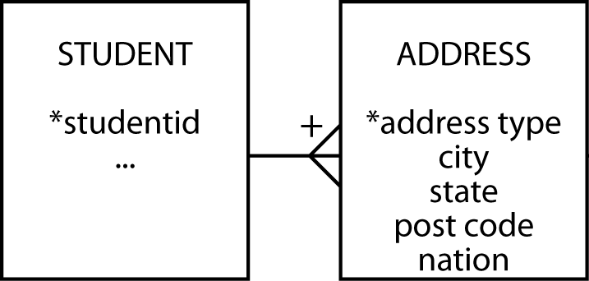
Names and addresses
The query test -- if an attribute has parts, are any of the parts ever likely to appear in a query?
Have an understanding on representing names and addresses in a data model

Slide 34
Hints on data modeling
Select names carefully.
Synonyms—different words that have the same meaning.
Get clients to settle on a common word or use views
Homonyms—same word has different meanings.
Clarify to avoid confusion.
Naming associative entities.
Concatenate entity names if there is no obvious real world name.
Uncover all exceptions.
Label relationships to avoid ambiguity.
Keep the data model well-formed and accurate.

Slide 35
Meaningful identifiers
An identifier is meaningful when some attributes of the entity can be inferred from the identifier’s value.
Advantages | Disadvantages
Recognizable and easy to remember | Identifier exhaustion
Administrative simplicity | Reality changes
 | Loss of meaningfulness

Slide 36
Recommendation
Nothing is lost and much is gained by using non-meaningful identifiers.
Non-meaningful identifiers serve their sole purpose well.
They uniquely identify an entity.
Attributes are used to describe the characteristics of the entity.
A clear distinction between the role of identifiers and attributes creates fewer data management problems.

Slide 37
Practice
An organization has several managers who work on one or more projects. Each project has an id, a name, and a goal. A manager always uses certain IT equipment items on a given project. A piece of equipment has an id, a description, and a date of purchase. The organization wishes to record the date when a given IT equipment item was assigned to a particular manager working on a specific project, as well as the total number of hours the manager has used the IT equipment for the project. Basic information about each manager should be kept. Each project has a manager as its leader, who will follow the project from its inception to its completion. It is possible for a manager to lead more than one project.
Draw the data model to accurately represent the situation above

Slide 38
Key points
A high-fidelity data model handles all exceptions.
Identifiers need only identify an instance.
Data modeling skills take time to develop.

